Slide 1
Annual Cycle of UTCI values (1950-2023) for Smart Cities in India

Slide 2
Introduction
The goal of this project is to analyze the Universal Thermal Climate Index (UTCI) trends across approximately 100 smart cities in India from 1950 to 2023. By processing historical climate data, the project aims to understand how thermal comfort levels have changed over time in urban environments

Slide 3
Data Acquisition
UTCI Data were downloaded from Copernicus Climate Data store
Time period: 1950-2023
Using cdsapi and request
Number of smart cities under study: 100
The list of smart cities included in this study can be accessed by below given link; Smart cities list

Slide 4
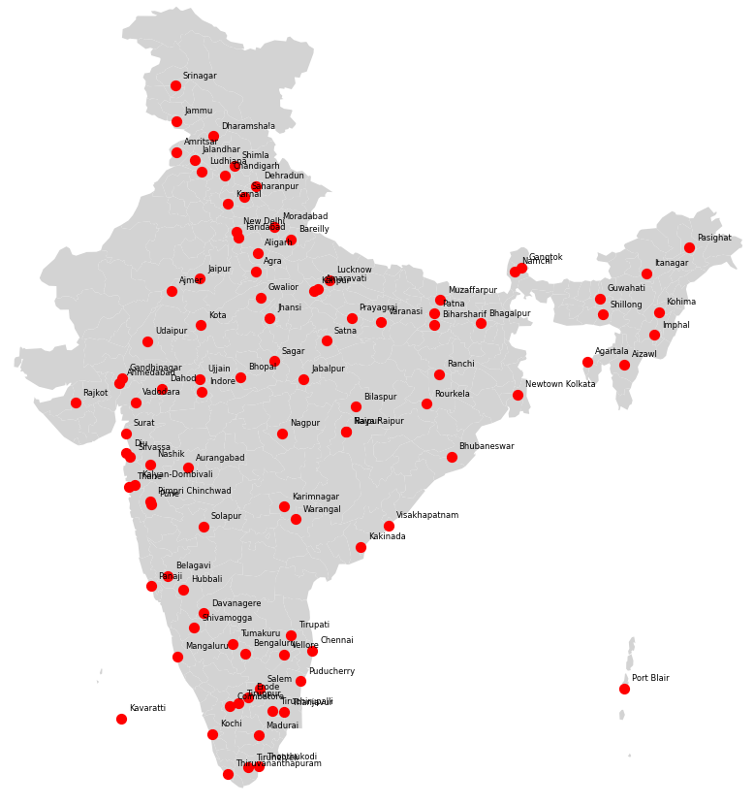
Smart Cities
100 smart cities in India were part of this study
The smart cities are well-distributed across all regions of India
distribution is fairly comprehensive but not completely uniform

Slide 5
Methodology
Download UTCI data (1950-2023) (Bounding box covering India)
Unzip and extract data
Processing the data: Calculate monthly average
Smart city specific UTCI Extraction: Used Lat and Lon coordinates of smart cities to extract UTCI data for each city
Trend ANalysis and visualization
The link provided below contain the Python code used for this analysis;
Code

Slide 6
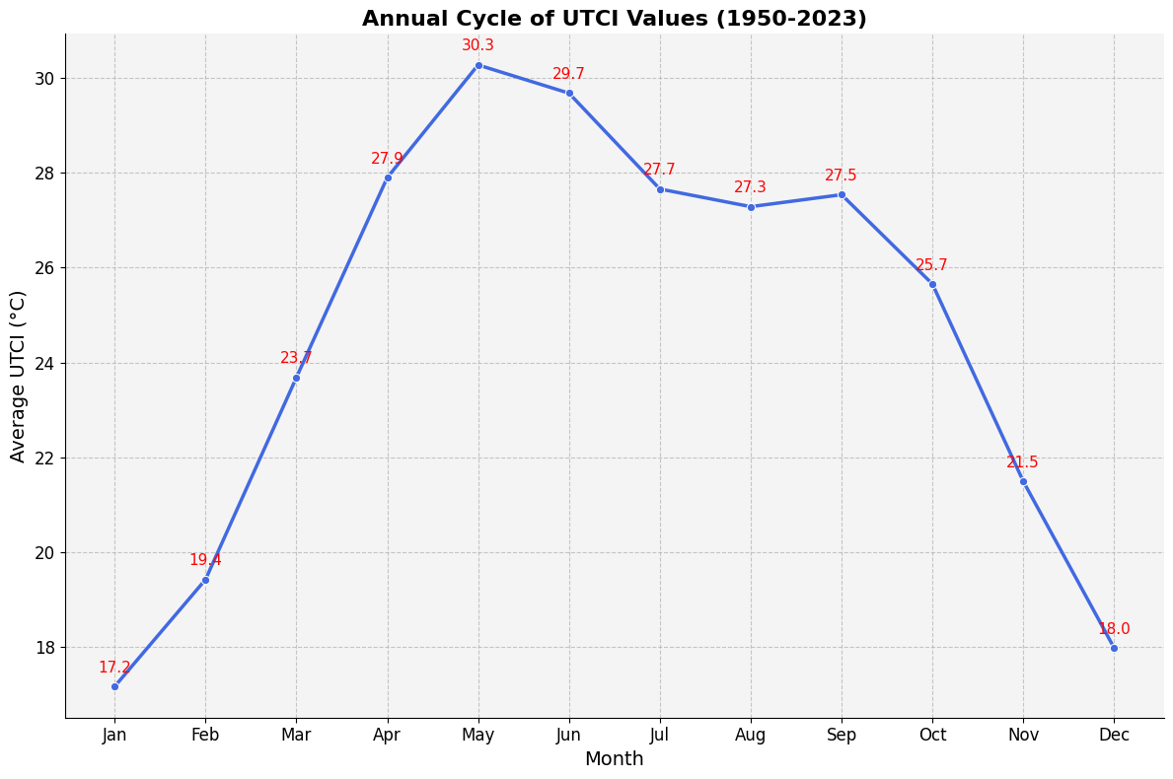
Visualization

Slide 7
Interpretation
Highest: May (30.3°C)
Lowest: January (17.2°C)
Rising Trend (Jan–May): Starts at 17.2°C in January, gradually increasing to a peak of 30.3°C in May.
Decline After May: Post-May, UTCI decreases slightly during June–July, This might indicate the onset of the monsoon, which brings cooling effects.
Post-Monsoon Decline (Oct–Dec): UTCI drops from 25.7°C in October to 18.0°C in December. This indicate the shift to winter.
Months like April–June show UTCI > 29°C, indicating heat stress conditions, which could impact health, productivity, and urban planning in smart cities.

